Slide 1
Art Dealer Game

Slide 2
Introduction
What is the Art Dealer Game?
A Python-based simulation game designed for third to fifth graders.
Players act as gallery owners trying to figure out a software salesperson's buying patterns.
The game uses a standard 52-card deck to create sets of four cards.
Core Technologies:
Tkinter for the user interface.
Pygame for sound effects.

Slide 3
Objectives
Player's Main Goals:
Select a set of four cards that the "art dealer" (the software) will purchase.
Correctly guess the dealer's purchasing pattern from a list of options.
Educational Impact:
An enjoyable and engaging way for students to learn.
Promotes critical thinking and problem-solving skills.
Players can review their performance statistics to improve.

Slide 4
Game Logic and Patterns
Core Mechanic:
The game starts with a shuffled 52-card deck.
Players select four cards to match a hidden pattern.
Example Patterns:
All cards have even values.
The sum of the four cards is greater than 20.
Two red cards and two black cards.
All cards are from different suits.
The hand contains two picture cards (Jack, Queen, or King).
Implementation:
Lambda functions are used to evaluate the selected cards against these patterns.
The game provides immediate feedback after each attempt.

Slide 5
User Interface and Interactivity
Built with Tkinter for a simple and interactive GUI.
Key UI Features:
Card Selection Area: A display of the digital deck for players to choose their four cards.
Pattern Guess Area: A section where players can guess the dealer's pattern.
Feedback and Results: Immediate notifications on whether the card selection was successful.
Game Flow Control: Buttons to start a new game, make guesses, and restart.
Enhanced Engagement:
Pygame is used to add sound effects, making the experience more enjoyable for children.

Slide 6
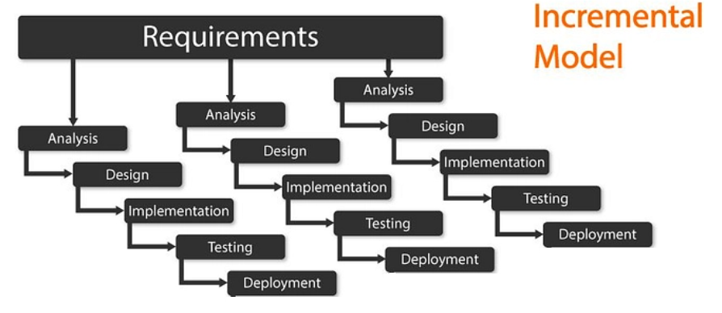
Process Model: The Incremental Approach
Model Used: Incremental Process Model.
Why this model?
It breaks down the project into manageable parts, adding features with each increment.
Ideal for building complex systems by starting with core functionalities.
Stages of Development:
Requirements Gathering: Defined the goal of creating a pattern-recognition card game for students.
Design: Focused on a user-friendly experience and planned the patterns.
Implementation: Started with basic card mechanics and incrementally added pattern-finding algorithms.
Testing and Feedback: Tested each new feature as it was implemented.
Deployment and Refinement: Final testing and UI improvements after all features were integrated.

Slide 7
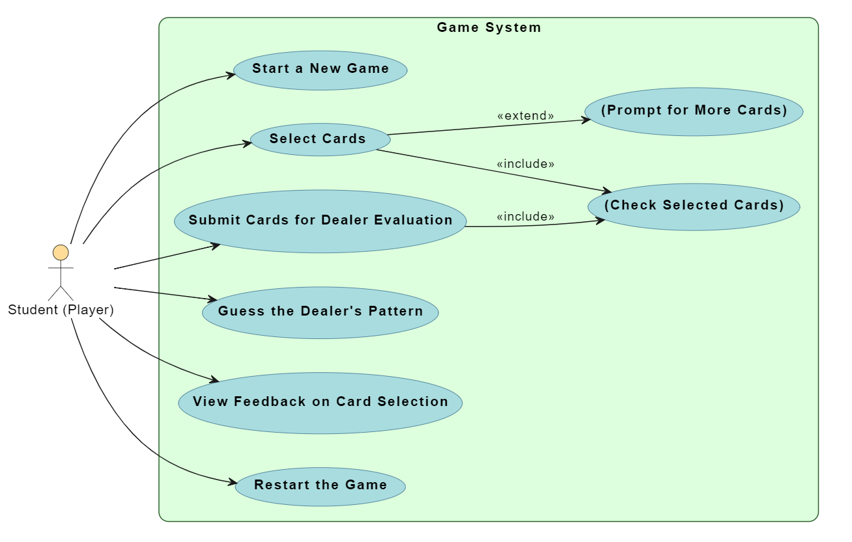
Use Case Diagram
Key Use Cases:
Start a New Game
Select Cards
Submit Cards for Dealer Evaluation
Guess the Dealer's Pattern
View Feedback on Card Selection
Restart the Game
Relationships:
<<include>>: Shows mandatory steps, like checking selected cards after submission.
<<extend>>: Shows optional behaviors, like prompting for more cards if not enough are selected.

Slide 8
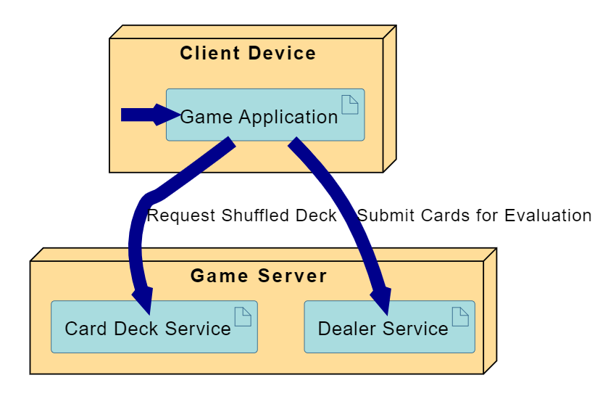
Deployment Diagram
Components:
Client Device: Where the player runs the game application.
Game Server: Hosts the core services for the game.
Card Deck Service: Manages shuffling and dealing of cards.
Dealer Service: Evaluates the player's card selections.
Data Flow:
The client requests a shuffled deck from the server.
The client submits selected cards to the server for evaluation.

Slide 9
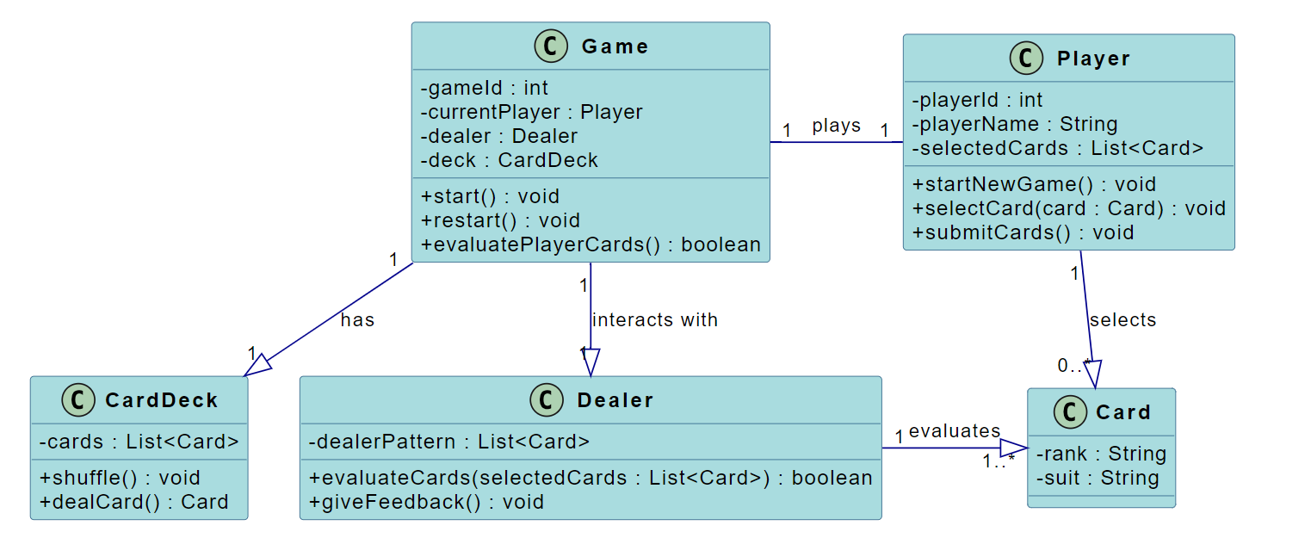
Class Diagram
Represents the core components and their relationships.
Primary Classes:
Player: Represents the user; selects and submits cards.
Game: Manages the game session, interacting with the deck and dealer.
CardDeck: Represents the 52-card deck; handles shuffling and dealing.
Dealer: Evaluates the player's cards against a pattern and provides feedback.
Card: Represents a single playing card with a rank and suit.

Slide 10
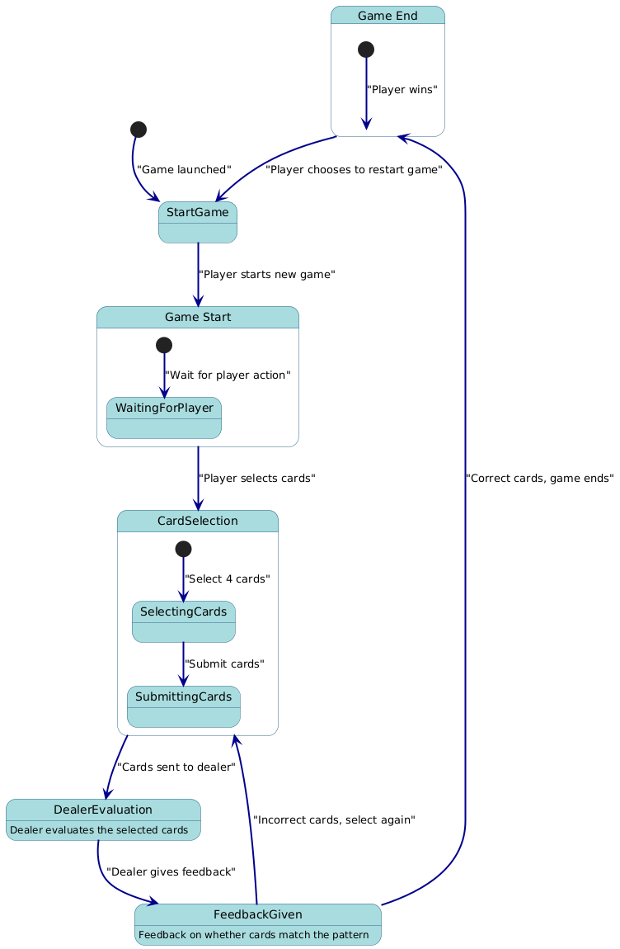
State Diagram
Represents the flow and different states of the game.
Game Flow:
Start Game: The game is launched.
Game Start: Waiting for the player to begin.
Card Selection: Player selects and submits four cards.
Dealer Evaluation: The dealer checks the submitted cards.
Feedback Given: The player is informed if their selection was correct or incorrect.
Game End: Reached when the cards are correct, with an option to restart.

Slide 11
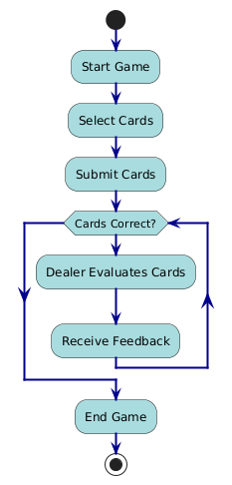
Activity Diagram
Represents the flow of activities in the game.
Key Activities:
The game starts.
Player selects cards.
Player submits cards.
Looping Mechanism:
A loop checks if the submitted cards are correct.
If incorrect, the player receives feedback and can resubmit cards.
The loop continues until the correct cards are submitted.
Once correct, the game ends.

Slide 12
Testing Strategies
Primary Goal: Ensure the game meets all requirements and is free of defects.
Scope of Testing:
Functional Testing: Core game mechanics like card selection and evaluation.
Non-functional Testing: Performance, security, and usability.
User Acceptance Testing (UAT): Verifying the game meets end-user expectations.
Types of Testing:
Functional: Unit Testing, Integration Testing, End-to-End Testing, Smoke Testing.
Non-Functional: Performance Testing, Security Testing, Usability Testing, Compatibility Testing.
UAT: Conducted with focus groups or end-users.

Slide 13
Persona: David Lee
Name: David Lee, 32, Software Engineer.
Background:
An avid gamer who enjoys strategy and card games.
Plays during short breaks and seeks mental challenges.
Goals:
To be mentally challenged.
Engaging and quick gameplay sessions.
Frustrations:
Games that lack strategic depth.
Unclear feedback mechanisms.
Quote: "I love games that challenge me intellectually and let me improve with every session.”

Slide 14
Customer Journey Map
Maps the player's experience from discovery to playing again.
Stages and Emotions:
Discovery: Finds the game and feels excited and curious.
Installation: Installs the game, feeling enthusiastic.
Game Start: Launches the game, feeling hopeful.
Card Selection: Engaged and focused while choosing cards.
Submit Cards: Feels anticipation and slight anxiety.
Dealer Feedback: Excited if correct, frustrated if wrong.
Game End: Happy if they win, determined to try again if they lose.

Slide 15
Conclusion
The Art Dealer Simulation is an educational game that successfully combines learning with engaging gameplay.
It effectively uses Python libraries like Tkinter and Pygame.
The project followed a structured development process, ensuring a robust and user-friendly final product.

